Slide 1

Helsinki 11.2.2020 @ Solita

Slide 2
k9wh1sper
Tieto Guest Wlan

Slide 3
About FAUG
Kinship through interest in Cloud Computing and Microsoft Azure
Founded in 2013 and now sporting over 1500 members
FAUG organizes over 10 events yearly
4 ‘regular’ meetups in Helsinki (each quarter roughly, 1 full day event)
Meetups elsewhere as possible (Turku, Tampere, Jyväskylä in the past)
IglooConf in January and PolarConf in October
Global Bootcamps, especially Global Azure Bootcamp in April
Have even the smallest interest to speak or host an event? Speak to us or any speaker, happy to have newcomers

Slide 4
What’s cooking?
1500 members 🎉
We’ve opened our planning sessions
Check out Meetup’s message board
Join #faug on bit.ly/msgurut Slack network
We’ve created sponsorship offering
We’re also creating ’event-in-a-box’-documentation and support to make the creation of your own FAUG event as easy as possible

Slide 5
FAUG Sponsorship Tiers
Tier | Description | Partner Cost
Event Host Partner | Single event location partner (e.g. FAUG Helsinki) | Venue + food
Conference Partner | IglooConf or PolarConf conference partner | From Bronze to Gold, between 1600 – 4900 €
Community Partner | Partner with visibility in all of the FAUG events for the year, includes Bronze visibility in both large conferences | 4500 €

Slide 6
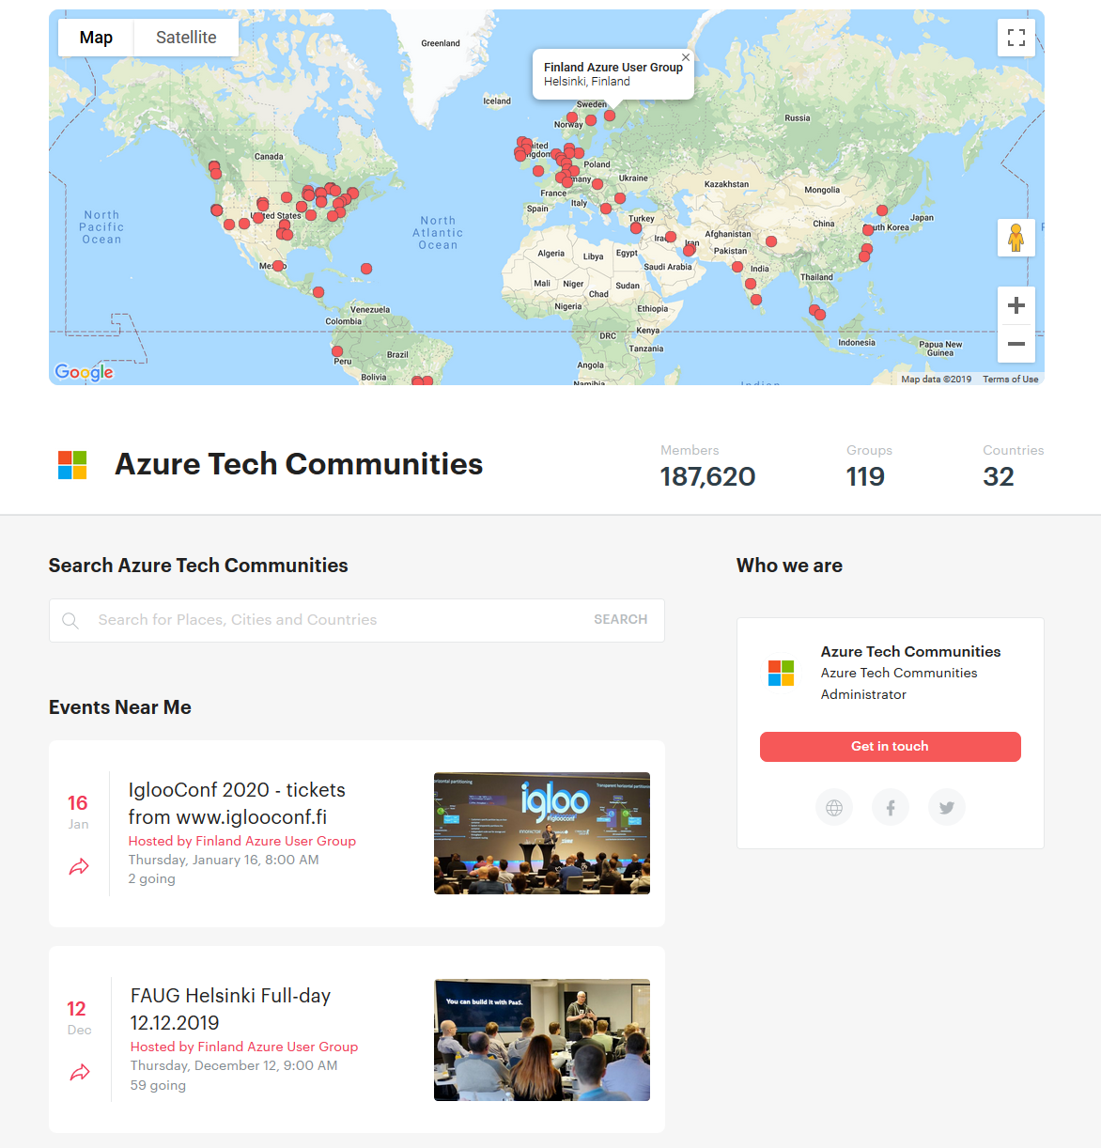
Notes:
We are listed in https://www.meetup.com/pro/azuretechcommunities/

Slide 7
Upcoming events in the scene
March 5-6, 2020 TechDays Finland in Helsinki
Agenda published
Global Azure Bootcamp 23.4 in Espoo

Slide 8
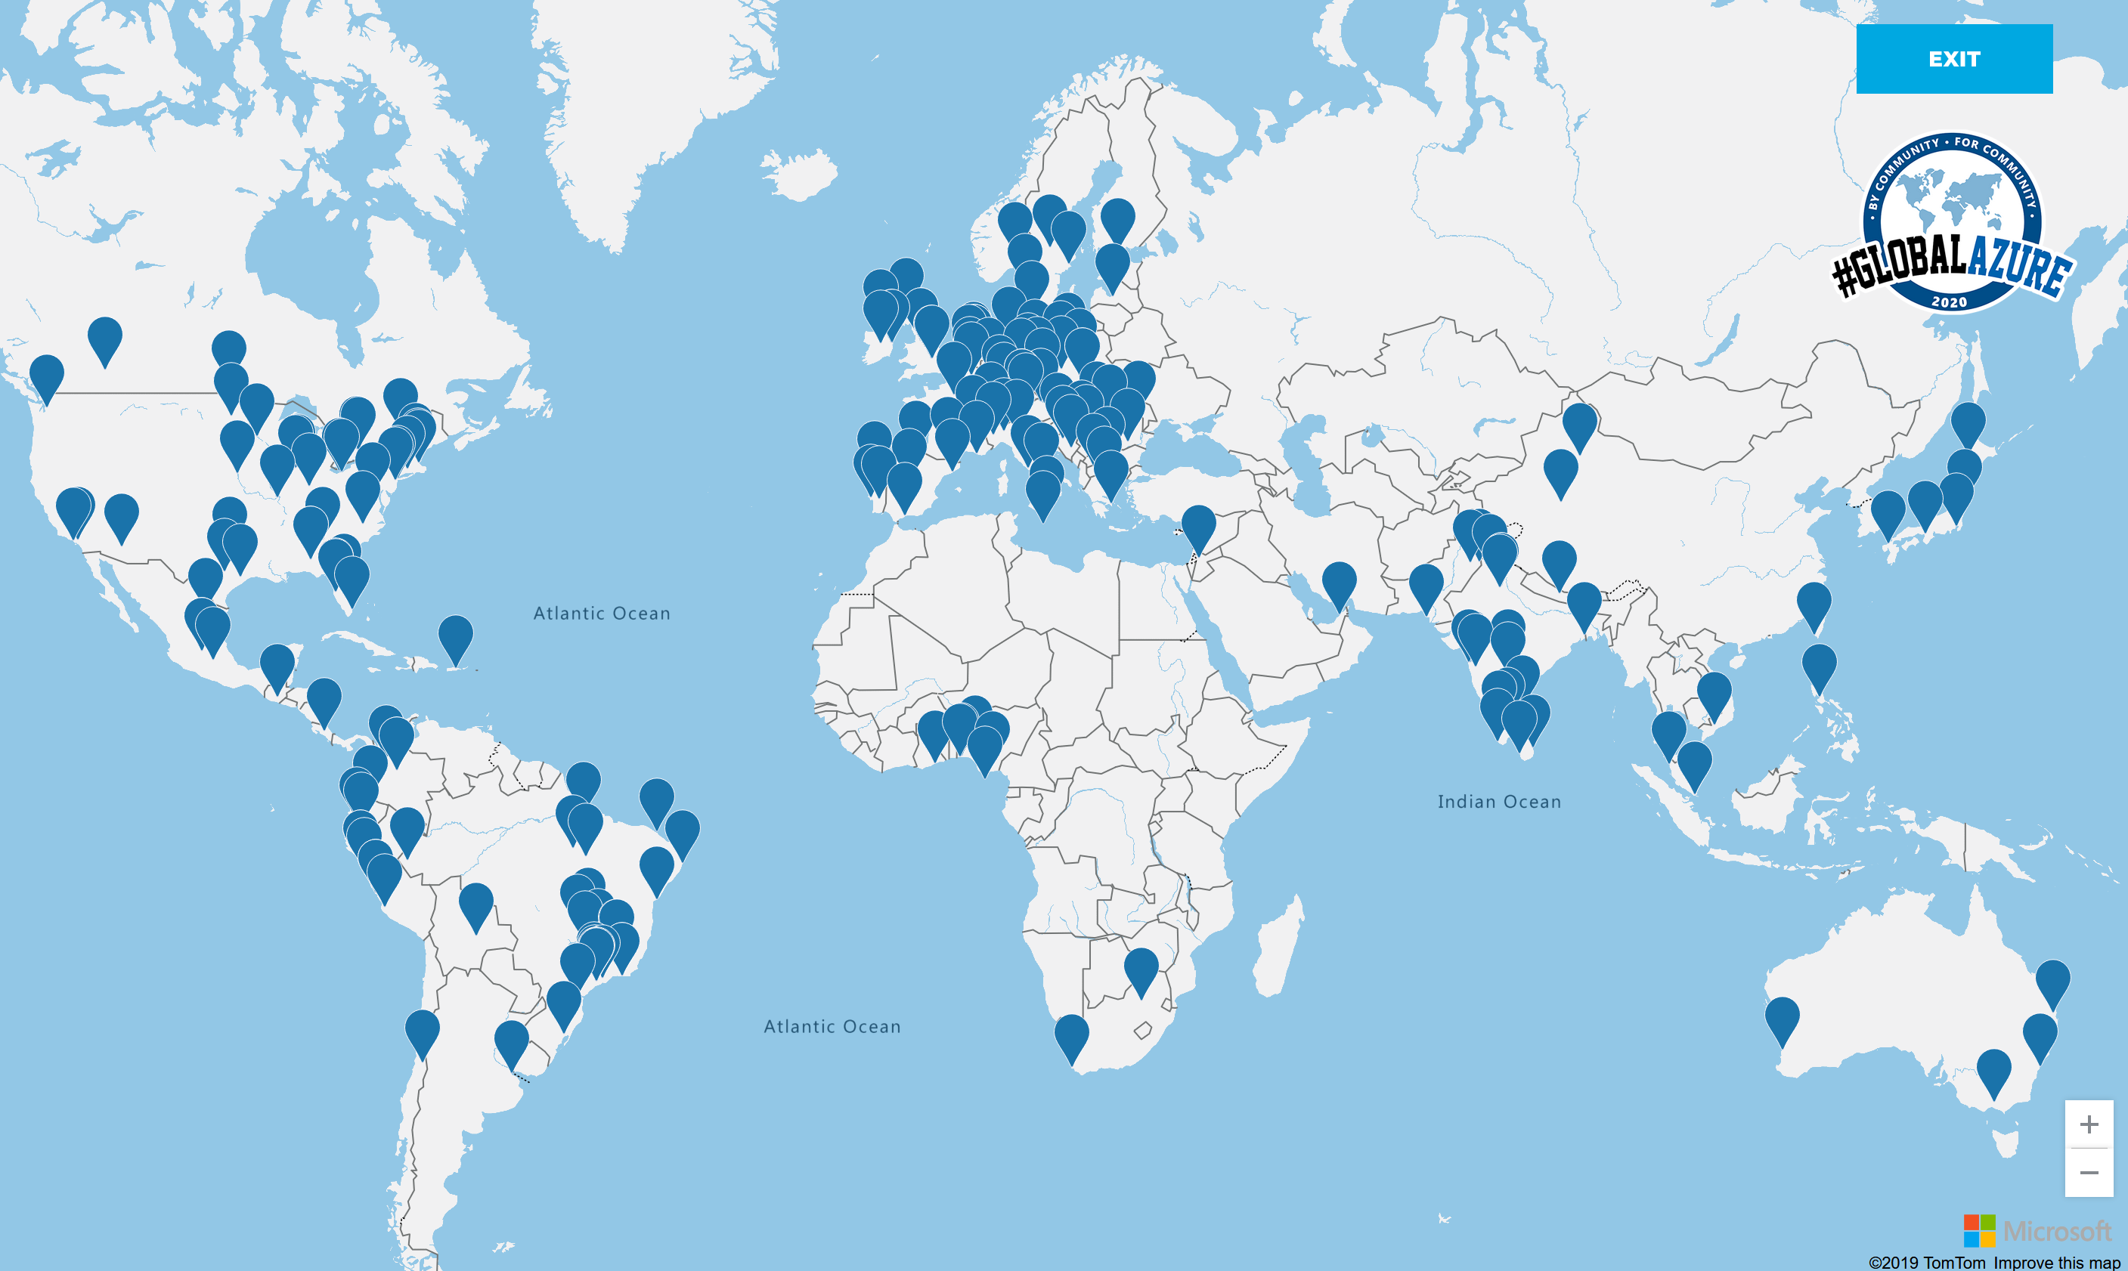
Notes:
https://globalazure.net/locations/fullscreen

Slide 9
Microsoft communities
Free MSGurut Slack channel (Finnish mostly) - bit.ly/msgurut Slack
Ikkunastudio podcast – ikkunastud.io or search in your podcast app
Teams user group
SharePoint user group
SQL server user group
Tikkanen Data (reach out to @vesat in msgurut Slack)

Slide 10
Today
• 16:30-16:45 Welcome Words by Sakari Nahi & Karl Ots • 16:45-17:30 Infrastructure as Code with Azure DevOps and Terraform, Joni Luomala • 17:30-18:15 Food • 18:20-19:10 Deploying your Azure solution using Azure DevOps and ARM by Teemu Tapanila • 19:15-20:00 Pipelines as Code: Azure Pipelines & YAML by Pasi Huuhka

Slide 11

Host

